Slide 1
SEC530
Presentation based on SEC530: Defensible Security Architecture and Engineering
Defensible Security Architecture and Engineering – Part 2: Thinking Red, Acting Blue – Mindset & Actions
© 2019 Justin Henderson and Ismael Valenzuela | All Rights Reserved
Notes:
Part 2 of three-part webcast series will cover some key winning techniques to do practical threat modeling and how to proactively define and implement effective security architectures and controls. This will be demonstrated through the simulation of modern threat scenarios.

Slide 2

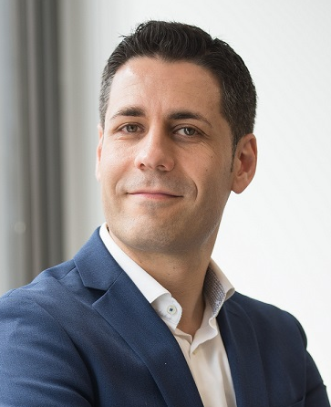
About Us
Justin Henderson
SEC555 Author / SEC455 and SEC530 Co-Author
GSE #108 / Cyber Guardian Blue + Red / 60 certs
Owner of H & A Security Solutions
Twitter: @SecurityMapper
Ismael Valenzuela
SEC530 Co-author / SEC503 and SEC511 Instructor
GSE # 132 and also a certification master
Sr. Principal Engineer at McAfee
Twitter: @aboutsecurity

Slide 3
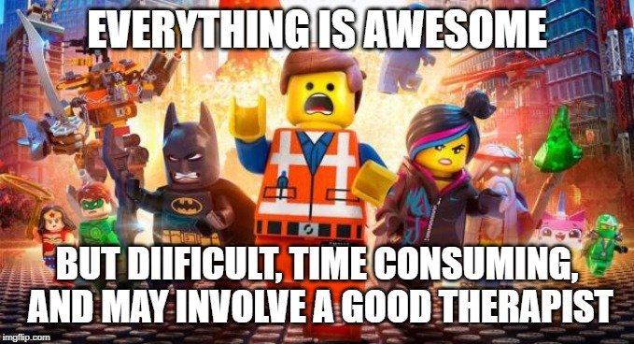
All Round Defender
Being an all round defender means you are the person responsible for:
Network Security
Routers / Switches / Software defined networking
Flow data
Firewalls / IDS and IPS / Sandboxing
Cloud Security
Hypervisors and central management
Infrastructure/Platform/Software/Function (as-a-Service)
Endpoint Security
Antivirus / Whitelisting / HIPS / EDR / Patching / Hardening / Logging / dare I go on?
Plus all the things that cross boundaries like data governance and identify management
Notes:
JUSTIN

Slide 4
Security Models, Standards, Frameworks, and Best Practices
Following references like models, standards, frameworks and best practices minimize the possibility of missing or forgetting a component in a security architecture
They also provide a common language that helps to explain your decisions
What security models, standards, frameworks and best practices should I follow?
Notes:
This page intentionally left blank.

Slide 5
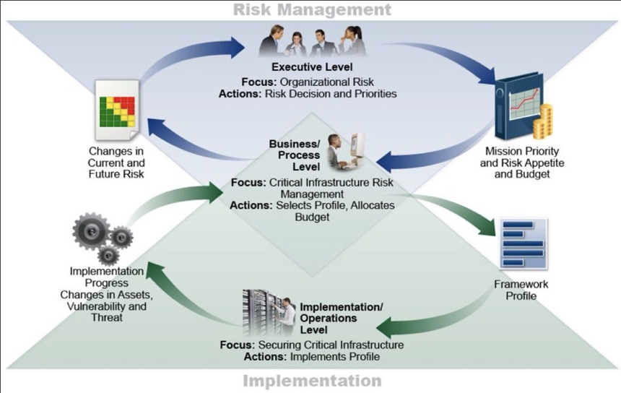
Risk-Driven and Business Outcome-Focused Architecture
Effective and valuable security architectures require measuring the risk, costs, and benefits of cybersecurity strategies and steps
NIST CSF (Identify, Protect, Detect, Respond & Recover) is a good document to use to navigate and cross-reference different standards and best practices
NIST CyberSecurity Framework v1.1, April. 2018
Notes:
Risk-Driven and Business Outcome-Focused Architecture
Lack of context against threat profiles and attack methods often lead to ineffective architectures. At the same time, security management must provide ongoing reporting to key stakeholders to prioritize investments and ultimately manage risk.
To address that need, the NIST Cybersecurity Framework¹ provides a common language for understanding, managing, and expressing cybersecurity risk both internally and externally. It can be used to help identify and prioritize actions for reducing cybersecurity risk, and it is a tool for aligning policy, business, and technological approaches to managing that risk.
NIST CSF provides mappings to CSC, COBIT, ISO 27001 and NIST SP 800-53, among others, so it’s a good document to use to navigate and cross-reference all these different standards and best practices that map to the domains we will use in this class. This will allow you to define architectures and implement controls that provide operational and cyber resilience while using a common language across your organization.
The Figure depicted on the slide describes a common flow of information and decisions at the following levels within an organization:
Executive
Business/Process
Implementation/Operations
The executive level communicates the mission priorities, available resources, and overall risk tolerance to the business/process level. The business/process level uses the information as inputs into the risk management process and then collaborates with the implementation/operations level to communicate business needs and create a Profile. The implementation/operations level communicates the Profile implementation progress to the business/process level. The business/process level uses this information to perform an impact assessment. Business/process level management reports the outcomes of that impact assessment to the executive level to inform the organization’s overall risk management process and to the implementation/operations level for awareness of business impact.

Slide 6
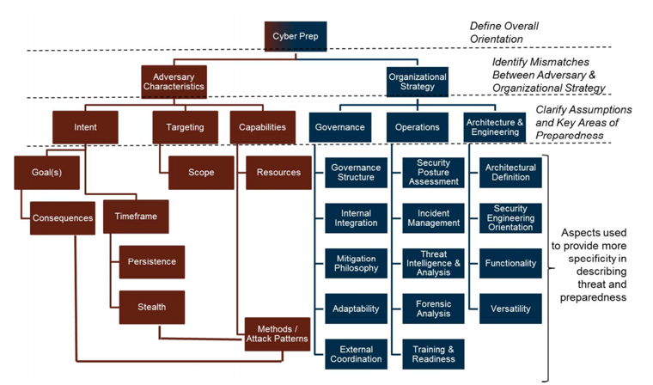
Practical Threat Modeling: Purple Teaming
We need to determine the characteristics of the adversaries which could be expected to target our systems so we can define and implement effective architectures and controls
Purple teaming (red + blue) facilitate this by working together through simulation of specific threat scenarios
MITRE Cyber Prep 2.0, May 2017
Notes:
Practical Threat Modeling: Purple Teaming
From MITRE Cyber Prep 2.0¹, May 2017:
Cyber Prep is a threat-oriented approach that allows an organization to define and articulate its threat assumptions, and to develop organization-appropriate, tailored aspects of a preparedness strategy. Cyber Prep focuses on advanced threats, but also includes material related to conventional cyber threats. Cyber Prep can be used in standalone fashion, or it can be used to complement and extend the use of other, more detailed frameworks (e.g., the NIST Cybersecurity Framework) and threat models.
An organization that seeks to improve its overall cybersecurity posture starts by acquiring cybersecurity products and tools and then abandoning them because it lacks the expertise or sufficient staff to use them effectively, or because it failed to clearly plan or resource the products and tools to make them operational. Cyber Prep helps an organization consider such interdependent aspects of preparedness as:
Governance: What is the organization’s overall approach to defending against cyber threats? How strongly integrated is cyber risk management with other aspects of organizational risk management? Is the focus on compliance or pushing state of the art to engage the APT better?
Operations: Is the organization simply reacting to incidents as they become evident, or are cyber defenders proactively engaging early and across the cyber attack life cycle? How much does the organization use threat intelligence in its operations? How integrated (or isolated) is the organization’s cyber security staff with other key players such as cyber defenders, malware analysts, and tool developers?
Architecture & Engineering: How well defined, and integrated with mission operations, is the organization’s security architecture? Are the organization’s security capabilities focused on some or all of the CSF core functions; do they go beyond the CSF and address aspects of cyber resiliency? What is the organization’s security engineering orientation?
Network architects and systems engineers should always seek to deploy defensive controls that are easy for the blue team (defenders) but make the red team's job (attackers) much more difficult
[1] https://www.mitre.org/sites/default/files/publications/16-0939-motivating-organizational-cyber-strategies.pdf

Slide 7
Look for Blue/Red Asymmetries
Network architects and systems engineers should always seek to deploy defensive controls that are easy for the blue team (defenders) but make the red team's job (attackers) much more difficult
For example: private VLANs
As we will discuss later in 530: private VLANs can be used to prevent clients from connecting to other clients
For organizations with good client/server network segmentation: this is often an easy win (users and IT staff usually fail to notice the change)
It prevents the client-client pivot: attackers can only pivot against servers
Notes:
Look for Blue/Red Asymmetries
Blue/red asymmetries offer great 'bang for the buck' to defenders. Another example is switch and router hardening, as we will discuss shortly. If performed properly: no end users will notice. But hardening switches and routers mitigate entire classes of attacks.
We will discuss all of the terms used above during 530. In the meantime: here's a quick primer.
A VLAN is a virtual LAN, a way to segment systems at OSI layer 2 (the data link layer, where switches live). A private VLAN means members of the same private VLAN cannot send traffic to each other. For client VLANs: it means the clients can send data to the switch, default gateway, DHCP and other servers, but not to other clients.
A pivot is an attack from one compromised system to another. It often occurs after one client is compromised (for example, during a phishing attack), and then the attacker uses that infected system to attack other internal systems (often behind the same firewall).

Slide 8
MITRE ATT&CK Matrix
Provides a common language to describe adversarial tactics and techniques
Applicable to real environments, allow mapping the attacker’s behaviors to defenses
Go-to model to plan & verify purple teaming exercises
https://attack.mitre.org/
Notes:
MITRE ATT&CK Matrix
ATT&CK stands for Adversarial Tactics, Techniques, and Common Knowledge. MITRE started this project in 2013 to document common tactics, techniques, and procedures (TTPs) that advanced persistent threats use against Windows enterprise networks. ATT&CK was created out of a need to document adversary behaviors for use within a MITRE research project called FMX. FMX’s objective was to investigate the use of endpoint telemetry data and analytics to improve post-compromise detection of adversaries operating within enterprise networks.
https://medium.com/mitre-attack/att-ck-101-17074d3bc62
It’s a LEARNING CURVE – requires a different mindset… some degree of maturity

Slide 9
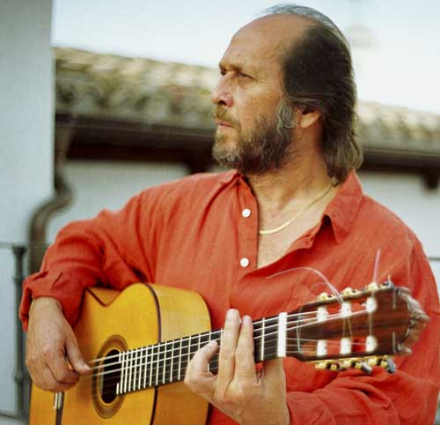
How Do We Learn? And.. Can We Learn Fast Please!!
Mastering a new skill requires deliberate practice!
“10,000 hours is the magic number of greatness.”
“People aren't born geniuses, they get there through effort.”
It’s doing it in a very specific, focused way. It's consciously zeroing in on what you're weak at and trying to correct it, rather than repeating what you've mastered.
Paco de Lucía, 1947-2014
"Outliers" (2008), by Malcolm Gladwell
Notes:
Its "an extraordinarily consistent answer in an incredible number of fields ... you need to have practiced, to have apprenticed, for 10,000 hours before you get good."
In his book, he uses Bill Gates or The Beatles as an example. “People aren't born geniuses, they get there through effort”

Slide 10

Can We Learn Faster Please?!
New studies in both science and psychology are showing new, or refined tactics and strategies that can help us become proficient, expert, masterful, or at least good in a specific domain in a lot less time than we might suppose.
These studies emphasize the quality of the practice over the quantity.
Source: http://www.makeuseof.com/tag/10000-hour-rule-wrong-really-master-skill/
Notes:
Its "an extraordinarily consistent answer in an incredible number of fields ... you need to have practiced, to have apprenticed, for 10,000 hours before you get good."
Let me give you just a few of these.

Slide 11

Create A Smart Feedback Loop
A way to spot your errors and identify potential improvements.
It’s about finding out exactly what you need to change to reach your goal more quickly.
Metrics? Anyone?
Continuous feedback loop for adaptive teaching and learning process using student surveys, from Brunel University, UK
Source: http://ijj.sagepub.com/content/early/2015/09/28/0306419015606618.abstract
Notes:
We can’t improve, or we can’t mature what we can’t measure.
Do we really have the metrics that we need? How do you identify your weak spots? How do you identify GAPS in your defensive posture?
Pentesting vs Red Teaming.
Do you know what is NORMAL in your environment? How do you measure that? How do you track progress over time?

Slide 12
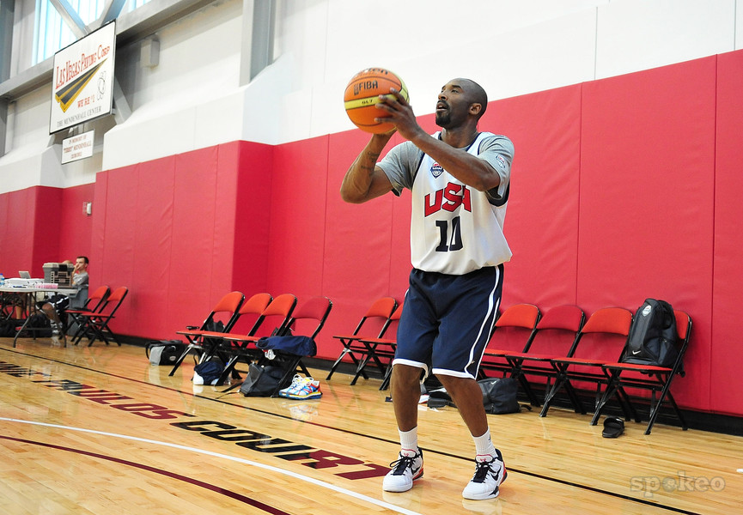
Deliberate Practice
Focus very deliberately on the sub-skills that make up an overall skill.
A highly structured activity engaged with the specific goal of improving performance in a certain area.
The Influence of Experience and Deliberate Practice on the Development of Superior Expert Performance, by K. Anders Ericsson.
Source:
http://www.skillteam.se/wp-content/uploads/2011/12/Ericsson_delib_pract.pdf
Notes:
Scanning over and over again. Long reports vulnerability centric. How’s that helping you to detect lateral movement or data exfiltration techniques?
Kobe Bryant would spend hours upon hours deliberately practicing 800 jump shots (rather than practicing the ‘whole game’) before most of us would even get up in the morning. He recognised that mastering the subs-kill of jump shots would propel him into master-status far more efficiently than any other skill. He focused his energies on this specific move — the move that he understood to have the most upside. The amount of time it took simply didn’t matter.

Slide 13
How Do We Get There?
Operationalizing
threat management
Maturing by rehearsing:
red teaming & threat hunting
DEV/OPS
RED TEAM
BLUE TEAM
Identify Objectives
Execute
Attack & Hunting Storyboards
Review & Measure
Update & Mitigate
Attack Playbooks
IR/HuntingPlaybooks
SOC Use Cases
Threat
Management
Lifecycle
Threat Models
IOCs
Logging
Attackers Motivations & TTPs
Threat Intel
Metrics
Notes:
MATURITY, CRAWL, THEN WALK
REHEARSING – HOW MANY HOURS NEED SOMEONE TO BECOME AN EXPERT IN SOMETHING – GUITAR PLAYERS?

Slide 14
Threat Management Lifecycle - A Smart Feedback Loop
Metrics are set upfront
Success is not measured on who wins or who loses
Provides ability to measure defensive capabilities and track progress over time
Regulates the tempo of the exercises
mean time to detection (dwell time or BK time)
mean time to remediation
Nr of simulations
Nr of gap identified
Nr of recommendations
Nr of tools written
Nr of updates to IR/Hunting playbooks
Nr of updates to SOC handbook
Notes:
IMPORTANT: This is not about who WINS or who LOSES.
Nr of conributions for wiki entries, etc.

Slide 15
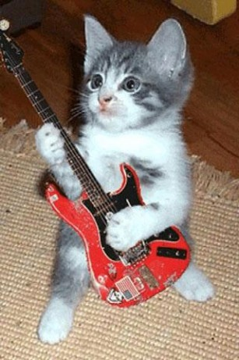
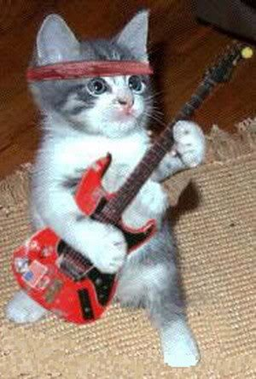

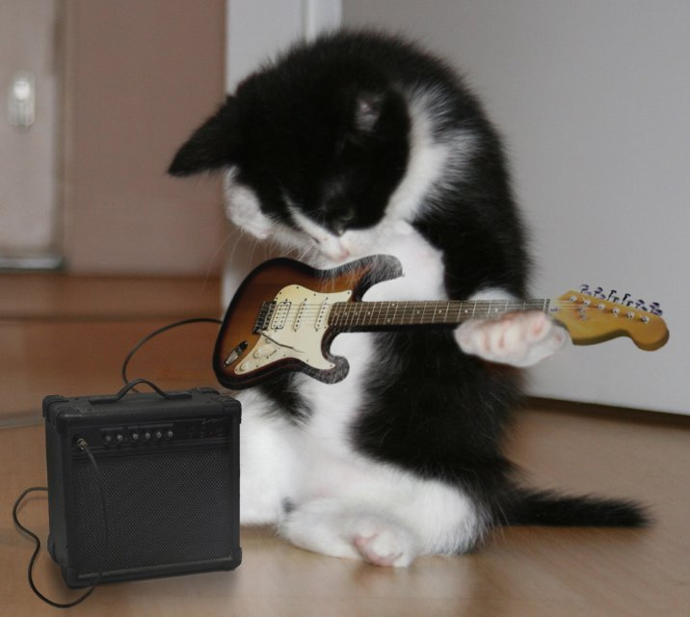
Maturing by Rehearsing
Guitar Noob
Cooperative Red Teaming
Red & Blue work together
Blue Team sees everything
Can play Wonderwall
Coordinated Threat Simulation
Based on specific threat models
Specific IOCs are determined
Can play in a Band
Adversary Simulation
No prior warning to Blue team
To understand motivation, behavior, TTPs
Ultimate Guitar Solo!
Full scope Attack Simulation
No prior warning to the Blue team
Make sure you take stakeholders though!
Notes:
Everyone goes onto the MD5s, hashes and IPs, YARA rule, and forget BEHAVIOR! Behavior helps us to understand how to ADD PAIN!

Slide 16
MITRE Adversary Emulation Plan Methodology
https://attack.mitre.org/wiki/Adversary_Emulation_Plans
Notes:
Metrics tell a great story!

Slide 17
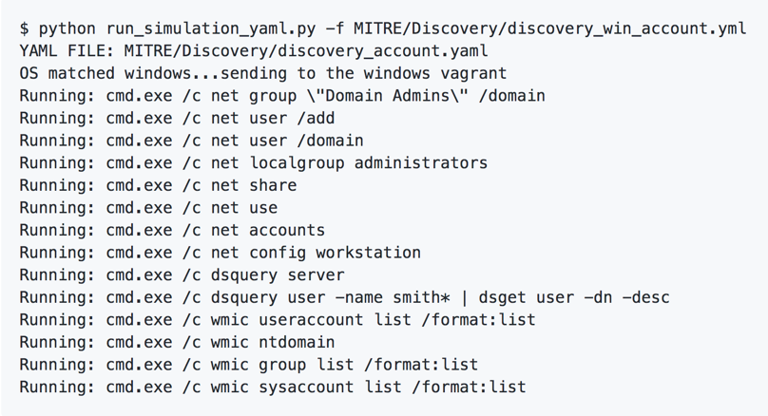
More automation!! – Uber Metta
Uber’s metta for adversarial simulation
https://github.com/uber-common/metta
Parses yaml files with actions sorted by MITRE ATT&CK
Notes:
The various actions live in the MITRE folder sorted by MITRE ATT&CK phases and also in Adversarial_Simulation

Slide 18
More automation!! - APT Simulator, RTA, Caldera and more
Florian’s Roth APT simulator, a Windows Batch script that makes a system look as if it was compromised
https://github.com/NextronSystems/APTSimulator
Other projects:
https://github.com/redcanaryco/atomic-red-team
https://www.endgame.com/blog/technical-blog/introducing-endgame-red-team-automation
https://github.com/mitre/caldera
Notes:
Better adversary simulation than Nmap+Cain+EICAR

Slide 19
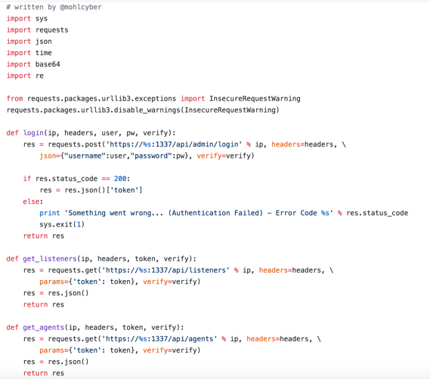
More automation!! – Using EMPIRE RestFul API
https://github.com/mohlcyber/Empire-API-Automation by @mohlcyber

Slide 20
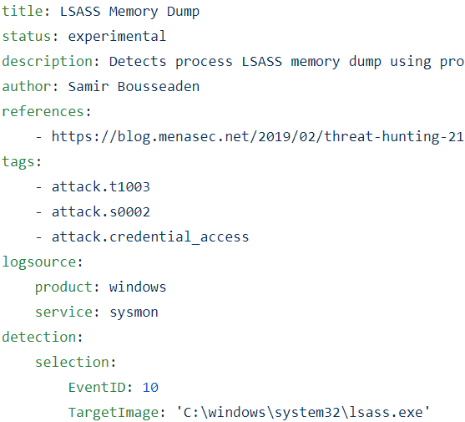
SIGMA Rules
Converter
Converts rule to Splunk
sigmac –I –t splunk –r rules/windows/sysmon
Converts rules to Elasticsearch
sigmac –I –t es-qs –r rules/windows/sysmon
sigmac does the heavy lifting
Rules conversion for anything!
Maps to MITRE

Slide 21
Other Resources
DeepBlueCLI
DetectionLab
The Hunting ELK
SOF-ELK
Malware Information Sharing Platform (MISP)
Mozilla InvestiGator
osquery
rastrea2r

Slide 22
Demo time!
Since we’re talking about cats…
Let’s use DNScat2!
http://tadek.pietraszek.org/projects/DNScat/
https://github.com/iagox86/dnscat2

Slide 23
Stay Tuned for Part 3!
Protect your Lunch Money - Keeping the Thieves at Bay
May 24, 2019 10:30 AM ET
Check @SecurityMapper & @aboutsecurity after this webinar for registration links
Notes:
In the final part of this three-part series, Protect your Lunch Money - Keeping the Thieves at Bay, we will talk about how in our industry, all too often, bad guys break into our networks and steal our lunch money, much due to the lack of data-centric controls. This webcast focuses on how to apply data-centric security through a combination of multiple security products.

Slide 24


Presentation based on SEC530: Defensible Security Architecture and Engineering
Thank you!!
References
https://www.sans.org/course/defensible-security-architecture-and-engineering
Notes:
There’s a lot more we could talk about... Check out SEC530.

